Slide 1
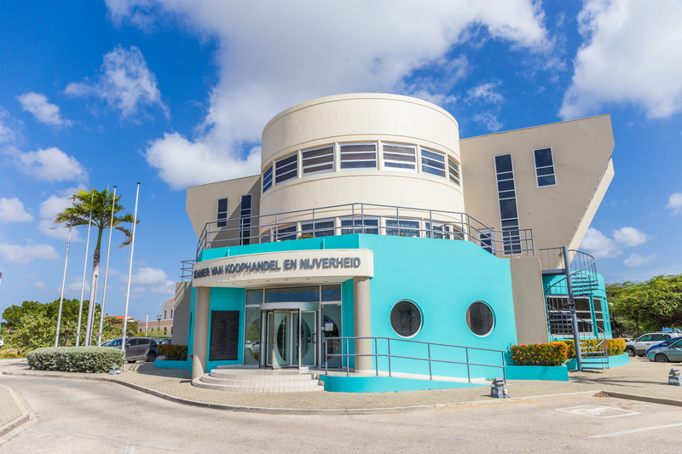
Chamber of Commerce and Industry

Slide 2
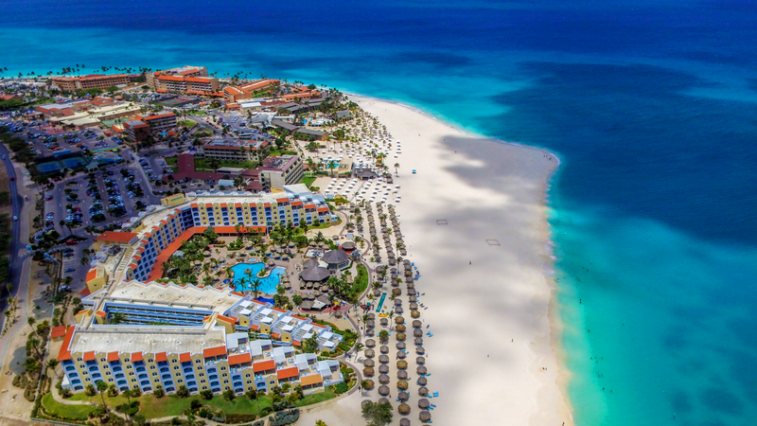
Vision of the Chamber
“To be the primary resource center for the business community in Aruba and foster a prosporous entrepreneurial environment”

Slide 3
Number of newly registered and still active companies by year of establishment. 1980-2021

Slide 4
Companies in Aruba
18.579
Active companies in Register of the Chamber of Commerce

Slide 5
5 most important sectors
3,700
2,278
2,141
1,944
1,861
Wholesale
Consultancy
Construction
Financial
Hotel & food
Wholesale and retail trade; repair of motor vehicles and motorcycles
Professional, scientific and technical activities
Construction sector
Financial and insurance activities
Accommodation and food service activities

Slide 6
Economic activities within the sector “Accommodation and food service activities”

Slide 7
Economic activities within the sector:
“Professional, scientific and technical activities”

Slide 8
The Chamber of Commerce can provide other kind of info relevant for trade or investment purposes:
Companies by region
Companies by legal form
Info from our registry
Source: CBA

Slide 9
New registrations in 2020 Cancellations and liquidations in 2020
In total 1,264 In total 566

Slide 10
Trade and investment opportunities in Aruba
Population
Economy
Security
Aruba ranks #10 in the world with regard to population density
Aruba ranks #23 in the world with regard to car density
Connectivity is of high quality, with more phones than people in the Island.
Multy-divers: people from 133 countries are living in Aruba
Most people speak 4 languages
Strategic location
Connectivity
ICT infrastructure
Skilled workfore
Judicial system
Tax incentives
Polítical stability
Support from Netherlands
Low crime rates
Outside the hurricane belt
Low level of inflation
Currency pegged to the US dollar

Slide 11
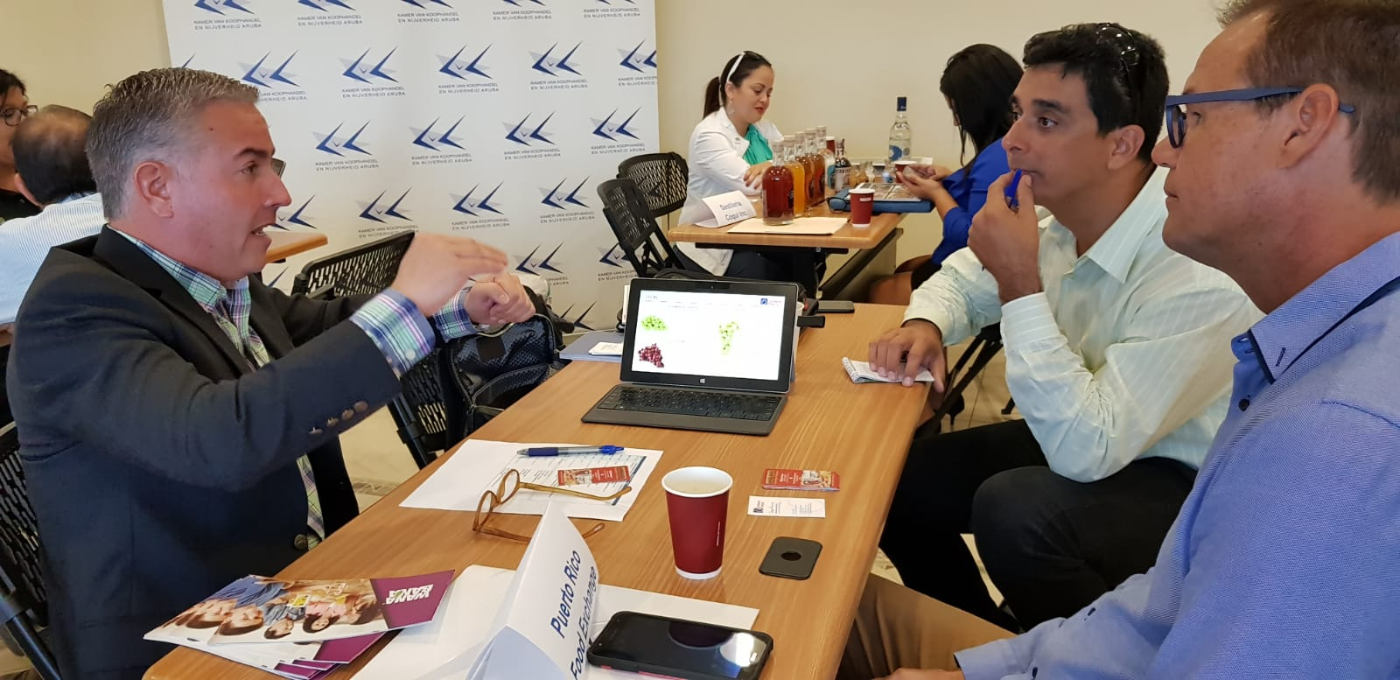
The Chamber of Aruba can help you. We:
Organize matchmaking
Facilitate trade missions
Provide personal business consultations
Give training and courses
Providing statistics about companies
Provide online registration of your company

