Slide 1


Aruba ‘One Happy Investment Island’
Department of Economic Affairs, Commerce and Industry

Slide 2
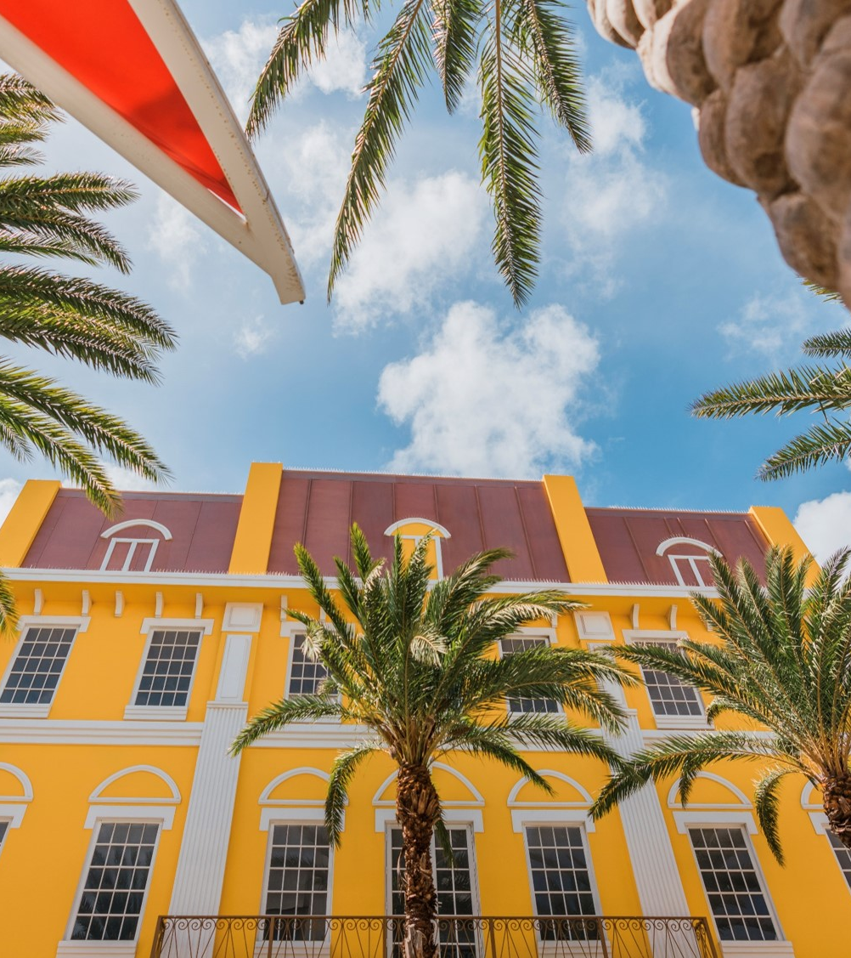

Content:
Economic Policy & Vision
The Promising Sectors
Choose Aruba
Aruba Investment Agency (ARINA)
ARINA Services

Slide 3
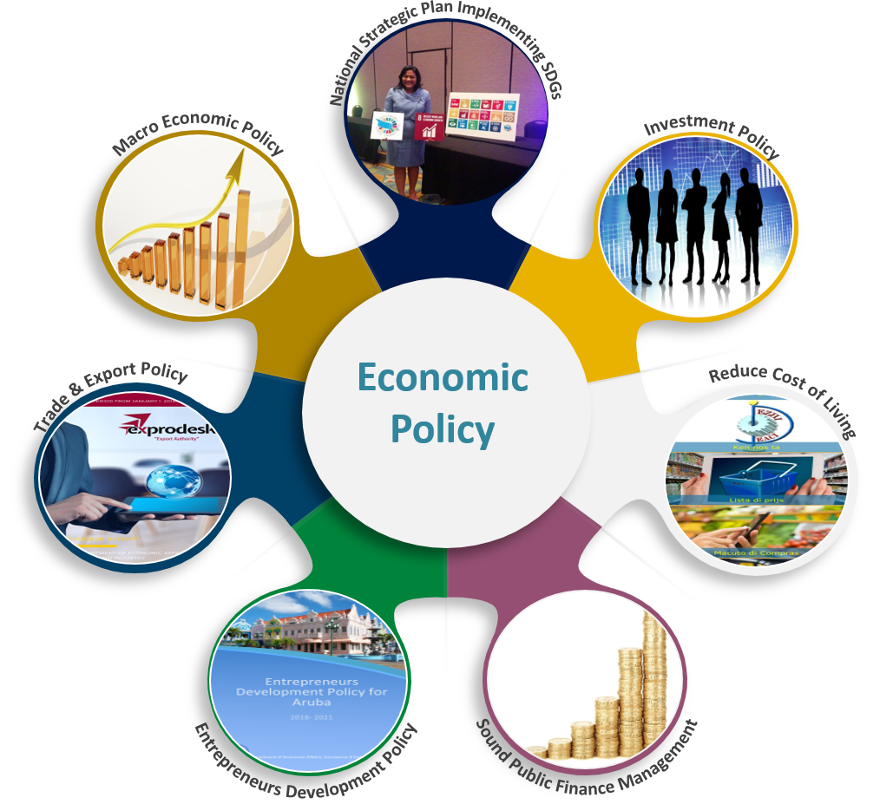
Working towards a
Strong and Resilient
Aruban economy

Slide 4

Economic Vision 2019 – 2022
“To improve the investment climate in Aruba and stimulate an innovative, competitive and diversified economy, which contributes to a higher quality of life for all citizens.”
Ministry of Finance, Economic Affairs and Culture
H.E. Minister Xiomara Maduro

Slide 5






The Promising Sectors
01
CULTURE TOURISM
SPORT TOURISM
ADVENTURE TOURISM
MEDICAL TOURISM
02
SOLAR ENERGY
OCEAN TECHNOLOGY
HIGHER EDUCATION
ICT, ISLAND BASED SOLUTIONS AS EXPORT
TOURISM
KNOWLEGDE ECONOMY
MARITIME SERVICES
AIRLINE SERVCES
PORT HUB (FZ)
HIGH VALUE GOODS STORAGE
TUGBOAT
03
LOGISTICS
AGRICULTURE
04
LOCAL ORGANIC FOOD PRODUCTION
CIRCULAR ECONOMY
CREATIVE INDUSTRIES
05
WASTE TO ENERGY
SEAWATER INDUSTRIES
REUSE OF WASTE
ART AND MUSIC
GRAPHIC DESIGN
PHOTOGRAPHY
WEB DESIGN
ART STUDIO
FASHION
06

Slide 6
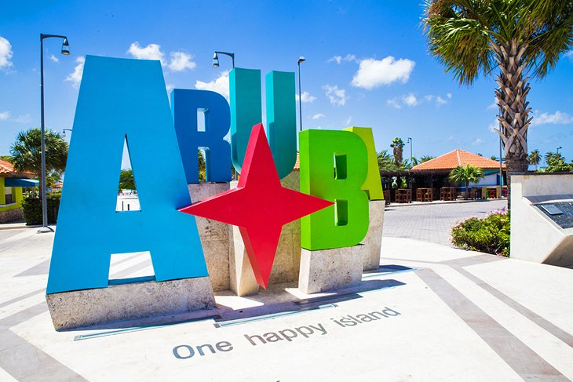
Choose Aruba
Why Aruba?
Human Capital
Quality of Life
Strategic Location
International Business Climate
Tax and Finance
Education
Stability
Safety and Security
Connectivity
‘One Happy Island’

Slide 7
Aruba Investment Agency (ARINA)
Who are we?
The official Investment Promotion Agency (IPA) of Aruba
Is responsible for identifying and attracting Foreign Direct Investments (FDI)
Main objective is to make it as easy as possible for investors to establish their businesses on Aruba
Extensive network
Public-private network

Slide 8
ARINA services
How we help?
Providing comprehensive intelligence about Aruba;
Providing sector and market information;
Advising and assisting the investor on investment opportunities and policies;
Introducing the investor to important and relevant contacts;
Assisting in government procedures (e.g. licenses and permits);
Offering site visit assistance;
Providing information on all procedures and requirements for establishment; and
Maintaining the relations with the existing investors.

Slide 9
Contact us
Aruba Investment Agency (ARINA)
L.G. Smith Boulevard 160
Sun Plaza
Oranjestad, Aruba
+297- 521 2400
Zulema Dabian-Erasmus
Z.Erasmus@Deaci.aw
Zuleika Quant
Z.Quant@Deaci.aw

