Slide 1
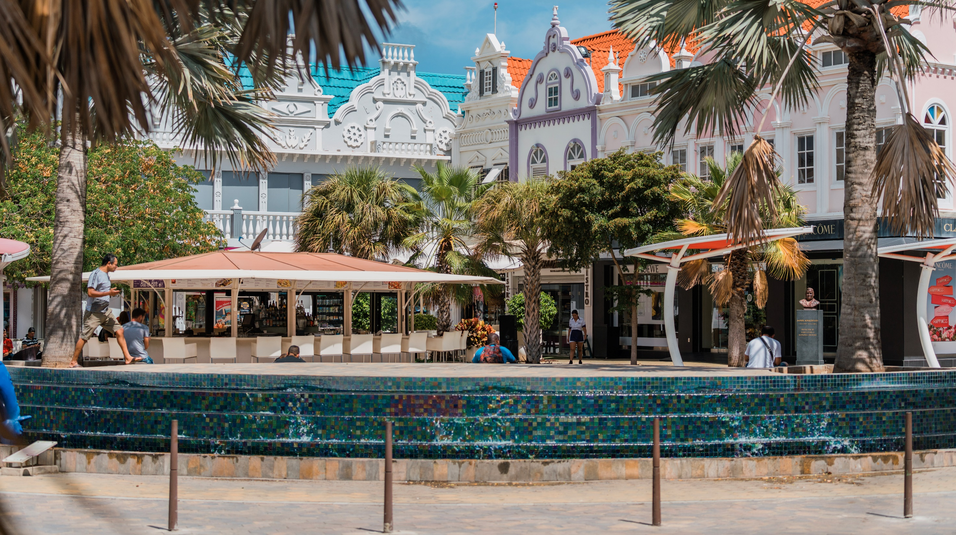
Trade relationship between CARIFORUM and Aruba
Department of Economic Affairs, Commerce and Industry

Slide 2
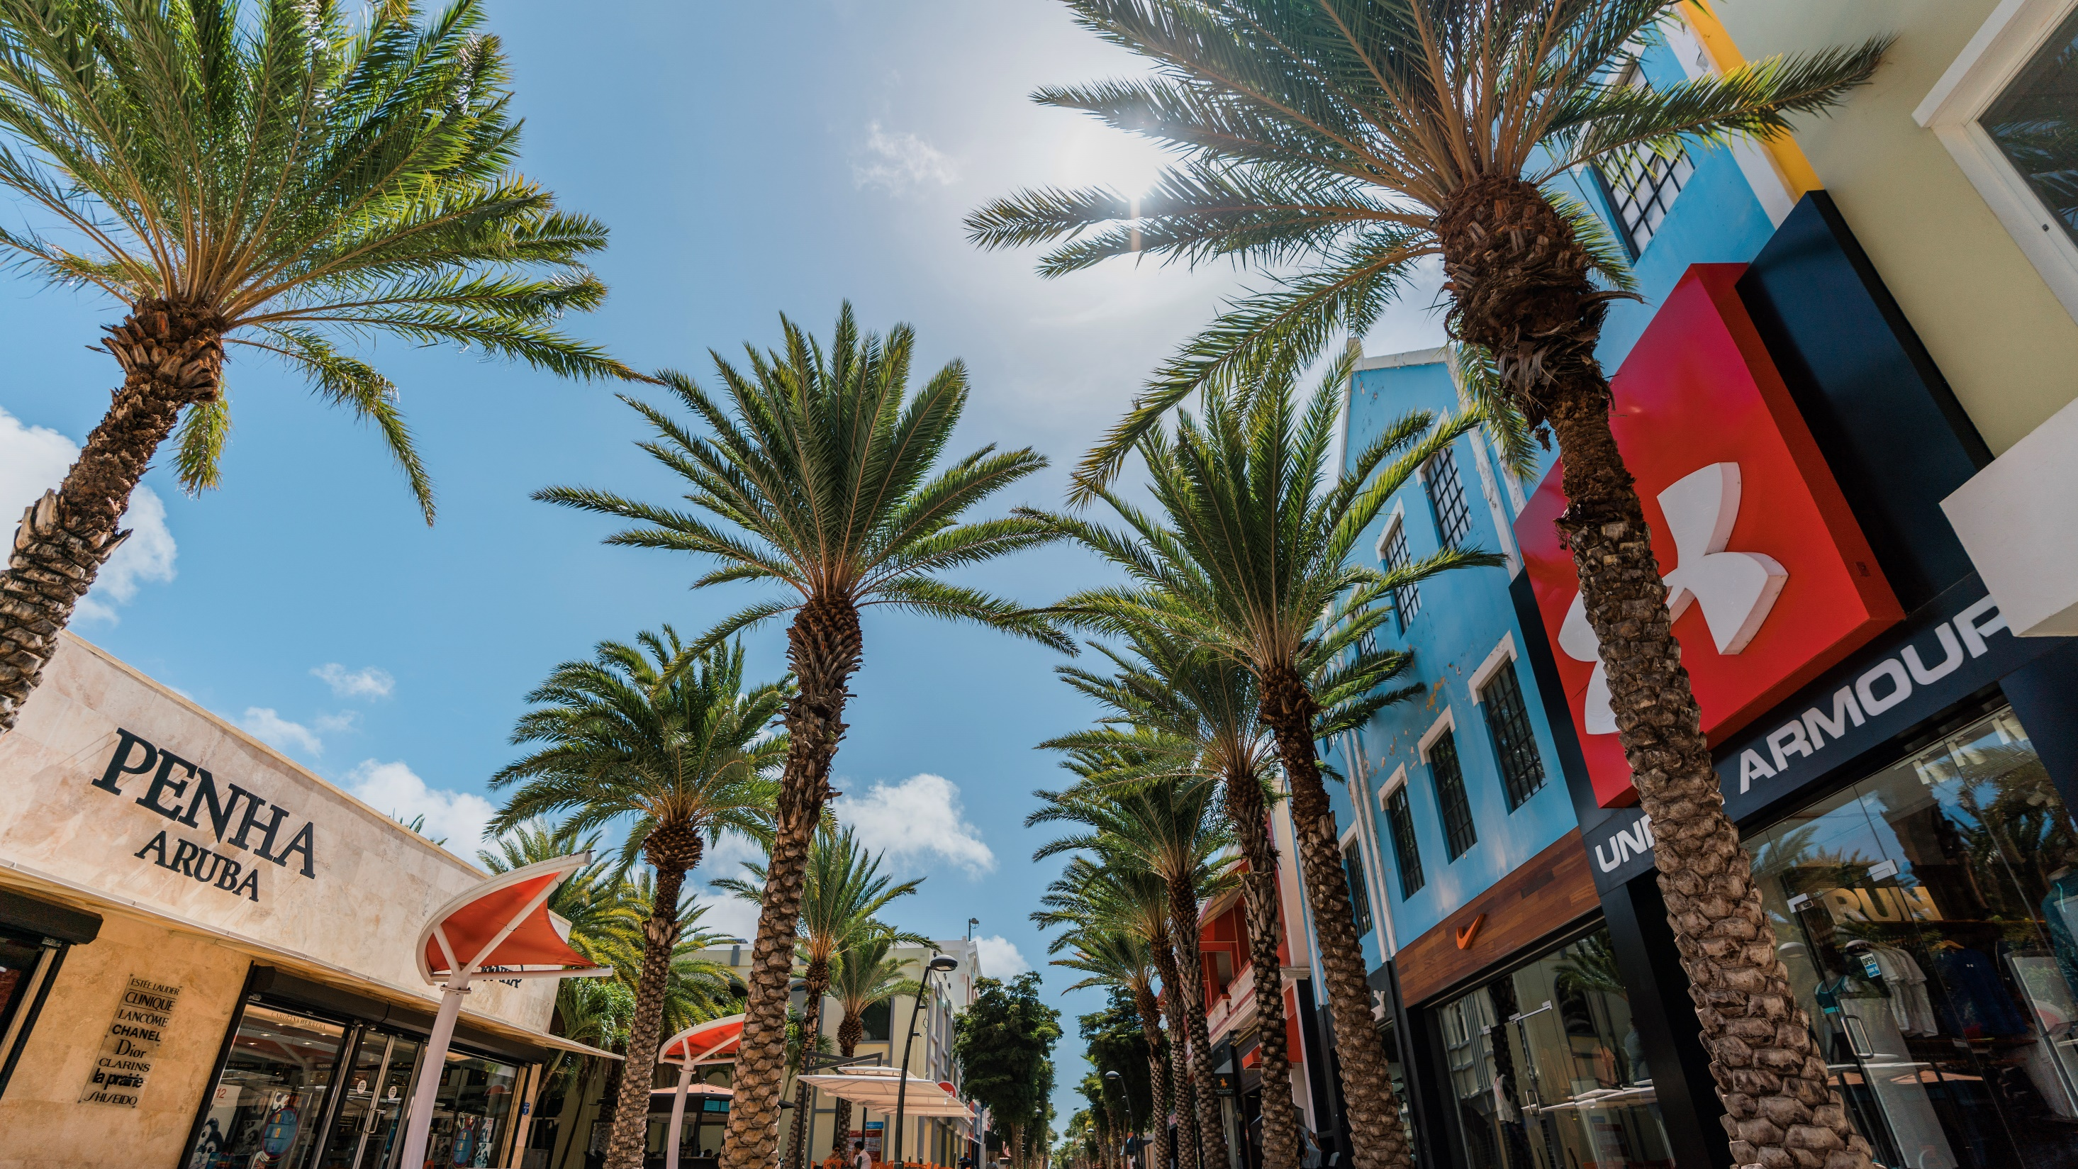
Content:
Aruba Overview
Importing and Exporting to Aruba
Aruban Exporters

Slide 3
Aruba Overview
Area
Sq Kilometers
180
112
34%
84%
Population
Foreign Population
Internet
2020
In thousands
2019
Share of Total
Proportion of individuals using the Internet

Slide 4
Aruba Economy
5.2%
5.6%
0.6%
Real GDP
Nominal GDP
Inflation Nominal GDP
2021
Optimistic Scenario
2021
Optimistic Scenario
2021
Optimistic Scenario

Slide 5
Aruba Economy
97%
63%
4%
5%
7,5%
SMEs
Tourism Industry
Tourism Receipts
Export
Unemployment
52% of employment
52% of the total amount of wages and salaries
Total receipts as percentage of GDP
Average annual growth rate of (2014-2017)
Businesses exporting products (excl. Freezone)
Unemployment rate
in 2020

Slide 6
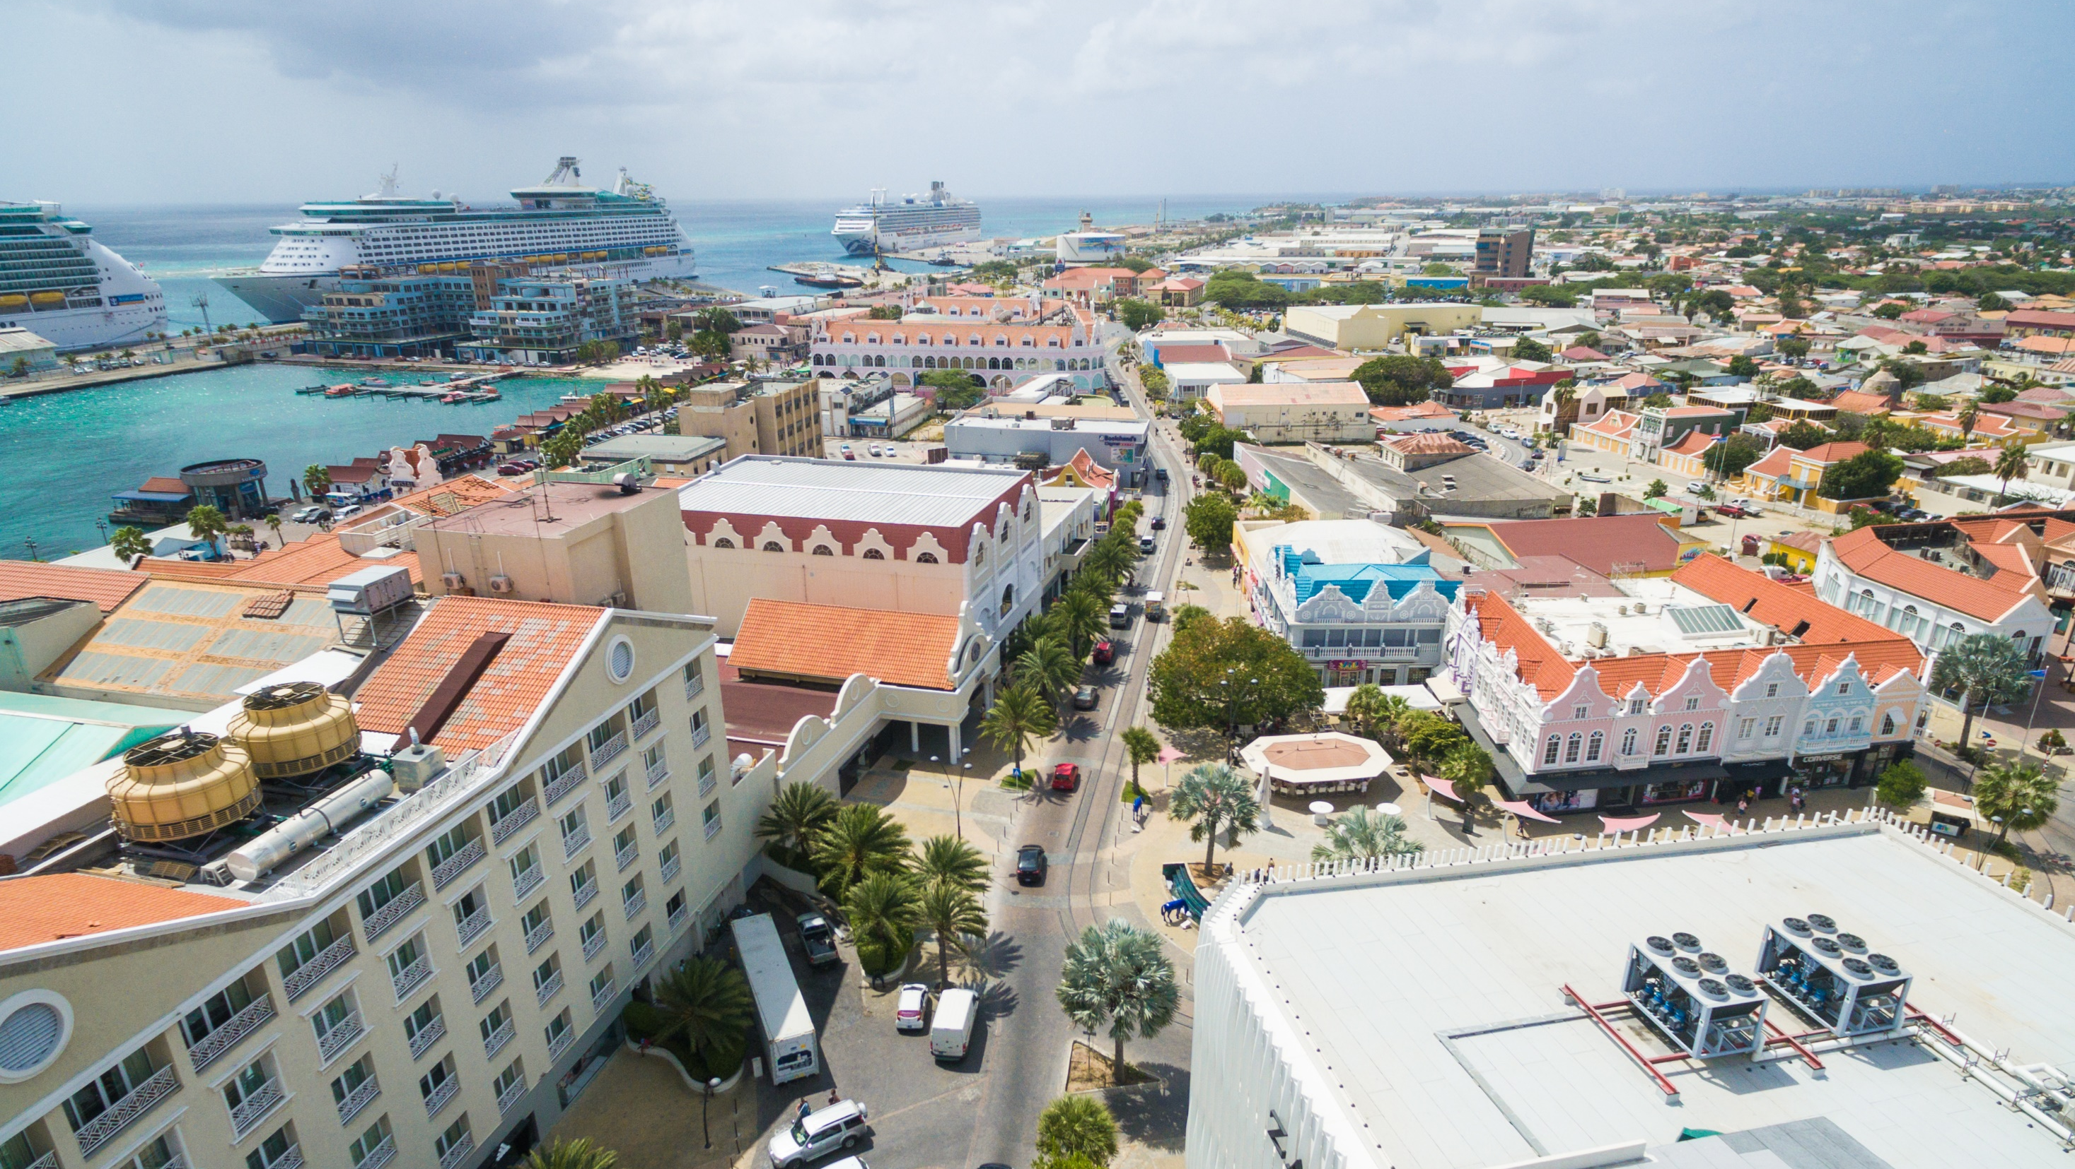
Trade Statistics
Importing and Exporting to Aruba

Slide 7
Total Imports
From CARIFORUM States to Aruba
Source: CBS Trade Statistics 2019- Aug 2020

Slide 8
Products Imported
From CARIFORUM States to Aruba
Product Description (Sum in Afls. Millions) | Antigua and Barbuda | Bahamas | Barbados | Belize | Dominica | Dominican Republic | Grenada | Guyana | Haiti | Jamaica | Saint Lucia | St. Vicent & the Grenadines | Suriname | Trinidad & Tobago
Live animals |  |  |  |  |  | 0.1545
Meat |  | 0.0922 |  |  |  |  |  |  |  | 0.0066 |  |  | 0.0025
Fish and seafood |  |  |  |  |  | 0.1535 |  |  |  | 1.4537 |  |  | 0.4806 | 0.0676
Dairy products |  |  |  |  |  | 0.4312 |  |  |  | 0.0203 |  |  | 0.0003 | 2.2924
Edible vegetables and certain root and tubers |  |  |  |  |  | 0.2727 |  |  | 0.0005 | 0.0106 |  |  | 0.1762
Edible fruits and nuts |  |  |  |  |  | 0.2035 |  |  |  | 0.0684 |  |  | 0.0938
Coffee, tea, mate and spices |  |  |  |  | 0.0089 | 0.9457 |  |  |  | 0.0012 |  |  | 0.0076 | 0.6373
Cereals |  |  |  |  |  | 0.0623 |  |  | 0.0014 | 0.8465 |  |  | 2.0788
Products of the milling industry |  |  |  |  | 0.0014 | 0.2183 |  |  |  | 0.1765 |  |  | 0.0212 | 0.0016
Animal or vegetable fats and oils |  |  |  |  |  | 0.0378 |  |  |  | 0.0003 |  |  | 0.0040 | 0.0726
Meat and seafood preparations |  |  |  |  |  | 0.0026 |  |  |  | 0.1596 |  |  | 0.0015 | 0.1326
Sugar and sugar confectionery |  | 0.0002 | 0.0097 |  | 0.0234 | 0.7538 |  |  |  | 0.1122 |  |  | 0.0047 | 0.0804
Cocoa and cocoa preparations |  |  |  |  |  | 0.0752 |  |  |  | 0.0003 |  |  |  | 0.5842
Pastrycooks' products |  |  |  |  | 0.0038 | 0.5909 | 0.0001 |  |  | 0.0165 |  |  | 0.0199 | 1.4007
Preparation of vegetables, fruit and nuts |  |  |  |  | 0.0065 | 0.2414 |  |  |  | 0.0230 |  |  | 0.0321 | 0.1772
Miscellaneous edible preparations | 0.0003 |  |  |  | 0.0064 | 0.6583 |  |  | 0.00005 | 0.0260 |  |  | 0.0686 | 2.0958
Beverages, spirits and vinegar |  |  | 0.0043 | 0.0003 | 0.0103 | 2.5326 | 0.0003 |  | 0.0009 | 0.1486 |  |  | 0.0231 | 0.7041
Prepared animal fodder |  |  | 0.0278 |  |  | 0.0372 |  |  |  | 1.4841 |  |  | 0.0338
Tobacco and manufactured tobacco substitutes |  |  |  |  |  | 6.2259 |  |  |  | 0.3810 |  |  | 0.1494
Salt, sand, stone and cement |  | 5.8315 |  |  |  | 2.4153 |  | 0.0006 |  |  |  |  |  | 3.2498
Petrochemical products |  |  |  |  |  | 0.0267 |  |  |  | 0.5670 |  |  | 0.0736 | 2.7962
Inorganic chemical products |  |  |  |  |  | 0.0015 |  |  |  | 0.0007 |  |  |  | 0.1430
Organic chemicals |  |  |  |  |  | 0.0759 |  |  |  | 0.0017
Pharmaceutical products |  |  | 0.8388 |  |  | 0.1870 | 0.0002 |  |  | 0.0004 |  |  | 0.0003 | 0.0211
Source: CBS Trade Statistics 2019- Aug 2020

Slide 9
Products Imported
From CARIFORUM States to Aruba
Product Description (Sum in Afls. Millions) | Antigua and Barbuda | Bahamas | Barbados | Belize | Dominica | Dominican Republic | Grenada | Guyana | Haiti | Jamaica | Saint Lucia | St. Vicent & the Grenadines | Suriname | Trinidad & Tobago
Paints, varnishes and inks |  |  |  |  |  | 0.1786
Perfumery and cosmetic preparations | 0.0001 | 0.0851 | 0.0312 |  | 0.0012 | 0.5527 | 0.0007 |  | 0.0023 | 0.0017 |  |  | 0.0041 | 0.3438
Soap, waxes, modelling pastes, and preparations with basis of plaster |  | 0.0005 | 0.0059 |  |  | 0.9170 |  |  |  | 0.0408 |  |  | 0.0003 | 0.1430
Miscellaneous chemical products |  |  | 0.3935 |  |  | 0.9875 |  |  | 0.0001 | 0.0017 |  |  |  | 0.0783
Plastics and articles thereof |  |  | 0.0008 |  | 0.0005 | 2.4992 |  |  | 0.0003 | 0.0159 |  | 0.0003 | 0.2370 | 0.2678
Rubber and articles thereof |  |  | 0.0004 |  |  | 0.3769 |  |  |  | 0.0001 |  |  |  | 0.0117
Wood and articles of wood |  |  |  |  |  | 0.1147 |  | 0.0475 | 0.0258 | 0.0208 |  | 0.0001 | 0.3124 | 0.0012
Paper and cardboard |  | 0.0009 | 0.0493 |  |  | 0.4418 |  |  |  | 0.0016 | 0.0022 |  | 0.0005 | 5.3034
Clothing of knitted and crocheted fabrics | 0.0010 |  |  |  |  | 0.0497 | 0.0001 |  | 0.0008 | 0.0250 |  | 0.0001 | 0.0000 | 0.0848
Clothing of not knitted and crocheted fabrics |  | 0.0003 |  |  | 0.0006 | 0.1614 |  |  | 0.00002 | 0.0010 |  |  | 0.0048 | 0.0076
Rags | 0.0006 |  | 0.0366 |  | 0.0170 | 0.3708 | 0.0006 |  | 0.0007 |  |  | 0.0001 | 0.0001 | 0.0272
Articles of stone, gypsum and cement |  |  |  |  |  | 0.4081 |  |  |  | 0.0118
Ceramic products |  |  |  |  |  | 0.0698 |  |  |  | 0.0342 |  | 0.0001 | 0.0013 | 0.0003
Iron and steel |  |  |  |  |  | 0.2089
Articles of iron or steel | 0.0004 |  | 0.0003 |  |  | 0.2933 |  |  | 0.0005 | 0.0280 |  |  | 0.0087 | 0.0078
Aluminium and articles thereof |  |  |  |  |  | 0.1008 |  |  | 0.0000 |  |  |  | 0.0015 | 0.0330
Reactors, machinery and mechanical appliances | 0.0002 | 0.0011 | 0.0073 |  | 0.0009 | 0.4551 |  |  | 0.0002 | 0.0567 |  | 0.0006 | 0.0136 | 0.0778
Electrical machinery and equipment | 0.0004 | 0.0006 | 0.0809 |  |  | 0.1678 |  |  | 0.0112 | 0.0178 | 0.0002 | 0.0004 | 0.0047 | 0.0444
Cars, motorcycles and cycles |  |  | 0.0132 |  |  | 0.0749 |  |  |  | 0.0153 |  |  | 0.0024
Ships, boats and floating structures |  |  |  |  |  | 0.7140
Optical, photographic, measuring and medical instruments and apparatus |  | 0.0003 | 0.0029 | 0.0004 |  | 1.2936 | 0.0002 |  |  | 0.0030 | 0.0089 |  | 0.0576 | 0.0380
Clocks and watches | 0.1008 | 0.0076 | 0.1376 |  |  | 0.0049 | 0.0031 |  |  |  | 0.2720
Furniture, mattresses, aticles for lighting and prefabricated buildings |  | 0.0003 | 0.0348 |  | 0.0004 | 1.7239 | 0.0006 |  | 0.00002 | 0.0027 |  | 0.0004 | 0.0115 | 1.2785
Miscellaneous manufactured articles |  | 0.0001 | 0.0013 |  |  | 0.0955 |  |  | 0.0018 | 0.0007 |  |  | 0.0011 | 0.0131
Migrants' effects | 0.0239 |  | 0.0071 |  |  | 0.0036 |  |  |  |  |  |  | 0.0226 | 0.0068
Source: CBS Trade Statistics 2019- Aug 2020

Slide 10
Top 10 Products Imported
From CARIFORUM States to Aruba
Sum in Afls. millions
Source: CBS Trade Statistics 2019- Aug 2020

Slide 11
Total Export
From Aruba to CARIFORUM States
Source: CBS Trade Statistics 2019- Aug 2020

Slide 12
Products Exported
From Aruba to CARIFORUM States
Product Description (Sum in Afls. millions) | Antigua and Barbuda | Bahamas | Barbados | Belize | Dominica | Dominican Republic | Grenada | Guyana | Haiti | Jamaica | Saint Lucia | St. Vicent & the Grenadines | Suriname | Trinidad & Tobago
Fish and seafood |  |  |  |  |  |  |  |  |  | 0.164174
Dairy products |  |  |  |  |  | 0.000516 |  |  | 0.000038
Coffee, tea, mate and spices |  |  |  |  |  |  |  |  |  |  |  |  | 0.00003
Cereals |  |  |  |  |  |  |  |  | 0.000511
Animal or vegetable fats and oils |  |  |  |  |  |  |  |  |  |  |  |  |  | 0.000935
Pastrycooks' products |  |  |  |  |  |  |  |  |  |  |  |  |  | 0.007339
Preparation of vegetables, fruit and nuts |  |  |  |  |  | 0.000099
Miscellaneous edible preparations |  |  |  |  |  |  |  |  |  | 0.00204 |  |  | 0.000071
Beverages, spirits and vinegar |  |  |  |  |  |  |  |  |  |  |  |  | 0.292196
Tobacco and manufactured tobacco substitutes |  |  |  |  |  | 0.180807 | 1.064024 |  |  |  |  |  | 1.214157
Pharmaceutical products |  |  |  |  | 0.000179 | 0.000032 |  |  |  |  |  |  |  | 0.000002
Paints, varnishes and inks |  |  |  |  |  | 0.000082
Perfumery and cosmetic preparations |  |  |  |  |  |  |  |  |  |  |  |  | 0.000204 | 0.001442
Miscellaneous chemical products |  |  |  |  |  | 0.000004 | 0.000004
Plastics and articles thereof |  | 0.001019 | 0.000009 |  |  | 0.01802 |  |  | 0.000022 | 0.001369 |  | 0.00006 | 0.000072 | 0.010567
Rubber and articles thereof |  |  |  |  |  | 0.000054 |  |  |  |  |  | 0.000179
Leather goods and traveling articles |  |  |  | 0.000162 |  | 0.001965 | 0.000358 |  | 0.000224 |  | 0.000358 | 0.000269
Wood and articles of wood |  |  |  |  |  | 0.000172 |  |  | 0.000368
Paper and cardboard | 0.000403 |  |  |  |  | 0.000217 | 0.000403 |  |  |  | 0.000179
Products of the printing industry |  | 0.000018 |  |  |  | 2.318988 |  |  |  | 0.000002 |  |  | 0.001476
Synthetic fibres |  |  |  |  |  | 0.000011
Carpets and other textile floor covering |  |  |  |  |  | 0.000035
Clothing of knitted and crocheted fabrics |  |  |  |  | 0.001692 | 0.00035 | 0.014518 | 0.000671 |  | 0.003072 | 0.000179 | 0.002004 | 0.000652 | 0.000353
Source: CBS Trade Statistics 2019- Aug 2020

Slide 13
Products Exported
From Aruba to CARIFORUM States
Product Description (Sum in Afls. Millions) | Antigua and Barbuda | Bahamas | Barbados | Belize | Dominica | Dominican Republic | Grenada | Guyana | Haiti | Jamaica | Saint Lucia | St. Vicent & the Grenadines | Suriname | Trinidad & Tobago
1162 Clothing of not knitted and crocheted fabrics |  |  |  |  |  | 0.001074 | 0.006321 |  | 0.003108 | 0.026924 |  | 0.001512 |  | 0.000537
1163 Rags |  | 0.002941 |  |  |  | 0.012242 |  |  | 0.003831 |  | 0.001367 |  | 0.00085
1264 Footwear |  |  |  |  |  |  | 0.007728 |  |  |  |  |  |  | 0.000153
1265 Headgear |  |  |  |  |  |  | 0.000562
1266 Umbrellas and walking-sticks |  |  |  |  |  | 0.000013
1267 Feathers, artificial flowers and articles of human hair |  |  |  |  |  |  |  | 0.000783
1368 Articles of stone, gypsum and cement |  |  |  |  |  | 0.000018
1369 Ceramic products |  |  |  |  |  | 0.000083
1370 Glass and glassware |  |  |  |  |  | 0.000202
1471 Pearls, precious stones, imitation jewellery and coins |  |  |  |  |  | 0.000895
1573 Articles of iron or steel |  |  | 0.00117 |  | 0.004028 | 0.014532 |  | 0.000895 | 0.000162 |  |  | 0.000054 |  | 0.015132
1576 Aluminium and articles thereof |  |  |  |  |  | 0.000273 |  |  |  |  |  | 0.000045
1582 Tools, utensils, cutlery and crockery |  |  | 0.000021 |  |  | 0.000075
1583 Miscellaneous articles of base metal |  |  |  |  |  | 0.011635 |  |  |  |  |  |  | 0.000018
1684 Reactors, machinery and mechanical appliances |  | 0.051545 | 0.00537 |  | 0.000179 | 0.026236 |  |  | 0.000836 | 0.037948 |  |  |  | 0.000367
1685 Electrical machinery and equipment | 0.000919 | 1.507587 | 0.007429 |  |  | 0.005903 |  |  | 0.000144 | 0.005391 |  | 0.000626 | 0.024109 | 0.000341
1787 Cars, motorcycles and cycles |  | 0.000249 |  |  |  | 0.061031 |  |  | 0.027477 |  |  |  | 0.00075
1890 Optical, photographic, measuring and medical instruments and apparatus |  |  |  | 0.000012 |  | 0.004683 |  |  |  |  |  |  | 0.12646
1993 Arms and ammunition |  |  |  |  |  |  |  |  |  |  |  |  | 0.004688
2094 Furniture, mattresses, aticles for lighting and prefabricated buildings |  |  |  |  |  | 0.010721 | 0.002096 |  | 0.00071 |  |  | 0.00071
2095 Toys, games and sports requisites |  |  |  |  |  | 0.000044 |  |  |  |  |  |  | 0.001222
2096 Miscellaneous manufactured articles | 0.000179 |  |  |  |  | 0.000018 |  |  | 0.000015
2197 Works of art, collectors' pieces and antiques |  |  |  |  |  | 0.009675
2198 Heritage, disasters goods and remains |  |  | 0.03112 |  |  | 0.007045 |  |  |  | 0.006604 |  | 0.005072
2199 Migrants' effects | 0.003334 |  | 0.02 |  |  | 0.056833 | 0.044291 |  | 0.157824 | 0.033663 | 0.00144 | 0.000407 | 0.02148
Source: CBS Trade Statistics 2019- Aug 2020

Slide 14
Top 10 Products Exported
From Aruba to CARIFORUM States
Sum in Afls. millions
Source: CBS Trade Statistics 2019- Aug 2020

Slide 15
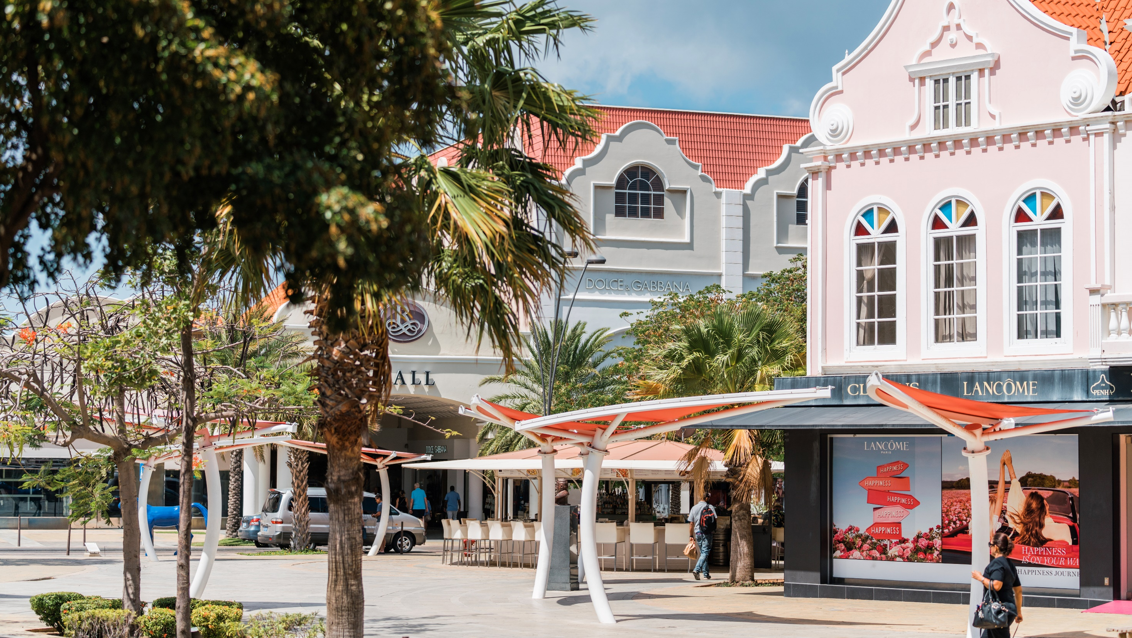
Aruban Exporters

Slide 16
Total Export from Aruba by the 15 most important Countries 2019
9%
41%
13%
7%
8%
18%
Source: CBS Trade Statistics 2019

Slide 17
Total Export from Aruba 2019
Source: CBS Trade Statistics 2019

Slide 18
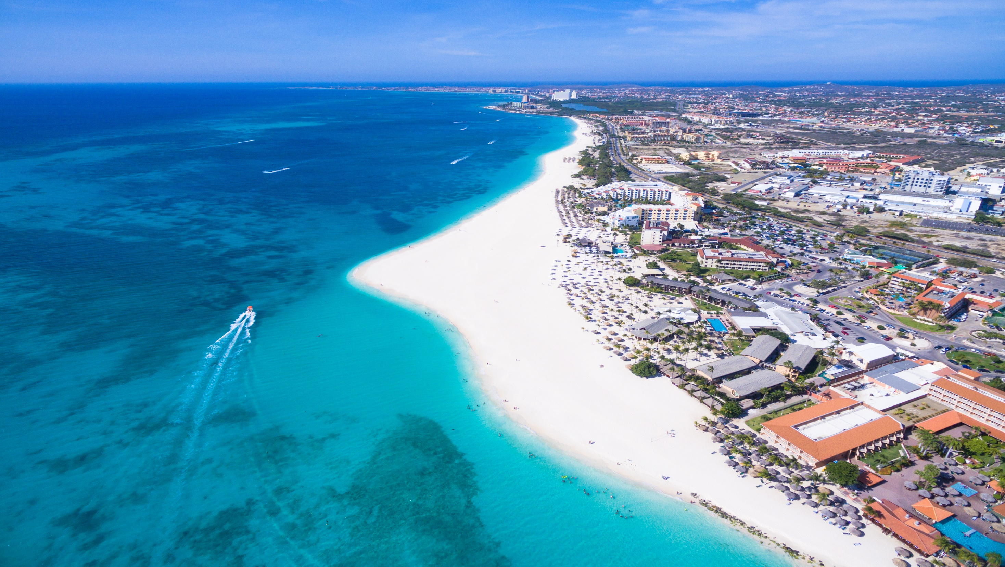
Aruba Exporters
Cultural and Creative Industry
Professional services
Products
General
Musicians/writers/composers
Tech professionals
Artisans
Lawyers
Advertising professionals
Architects
Accountants and financial advisers
Consultants
Hot sauces
Bijouterie
Liquor

Slide 19
Exprodesk
Export Promotion Desk Aruba
We offer free customized information and coaching to (potential) exporters and organizations
We offer free workshops, training, lectures and presentations
We assist with trade missions
We conduct research to obtain accurate and valid data that is used in the brochures, flyers and policies
We develop partnerships and strategic alliances to pursue our objectives and to better assist our clients

