Slide 1
FreeZoneAruba
Your Facilitator
For International Business
FreeZoneAruba

Slide 2
FreeZoneAruba(FZA) NV
Incorporation FZA NV
Small and multifunctional team of professionals
FreeZoneAruba

Slide 3
One Stop Shop
Concession
No Red Tape
Intermediary for permits bank accounts, Customs, Port Authorities, etc.
FreeZoneAruba

Slide 4
What do we offer?
Warehouses/Offices for rent
Property to construct facilities: Barcadera
Designate property as free zone
FreeZoneAruba

Slide 5
Benefits
2% profit tax
0% import duties on import-export products, goods and materials for facility construction, operations, machinery, equipment, etc.
0% turnover tax (BBO), health tax (BAZV), BAVP & dividend tax
Exemption from foreign exchange provision
FreeZoneAruba

Slide 6
Benefits - 2
Foreign ownership
Swift license expansion (24 hours)
No minimum investment required
No minimum amount of employees required
25% of goods may be sold to local market
Island wide location establishment
FreeZoneAruba

Slide 7
What can you do?
Limited Services
Trade
(Light) Industrial
Drop shipments
Showcasing
Hub
FreeZoneAruba

Slide 8
Additional (local) activities with free zone benefits
Sustainable energy
Sustainable food supply
Medical tourism
Maintenance, repairs, restoration activities
Waste management
New: innovative services
FreeZoneAruba

Slide 9
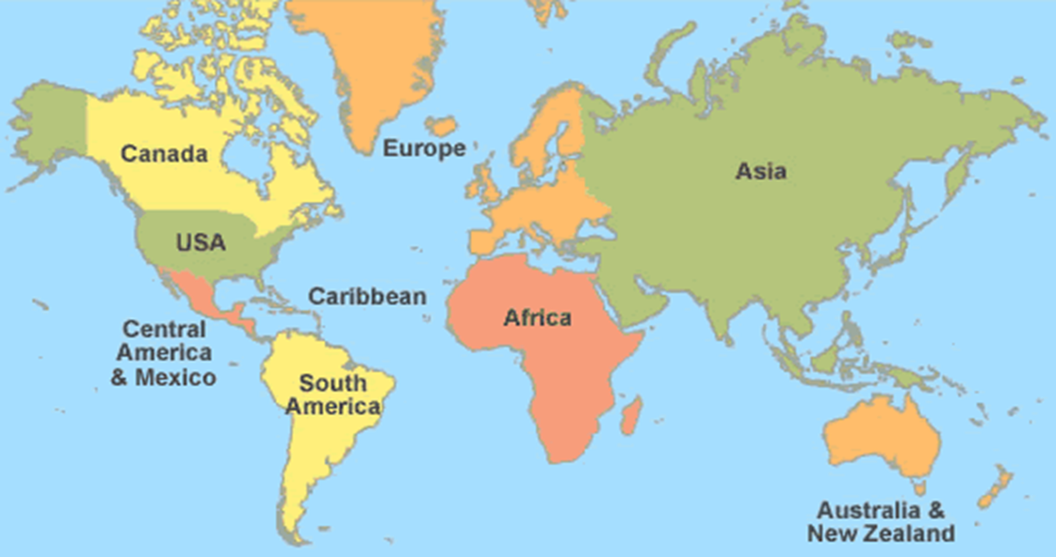
Export Countries
FreeZoneAruba

Slide 10
FreeZoneAruba
Contact information
+297-582-0909
www.freezonearuba.com
account.executive@fzanv.com
FreeZoneAruba

