Slide 1

10.5M Ounce Total Gold Resource
ETK Inc.
A Guyana Corporation
The Toroparu Gold Project
Advancing One of the Largest Undeveloped Gold Deposits in South America Owned by a Junior Development Company
A Subsidiary of Gold X Mining Corp
Publicly Listed on TSX-V and OTCQX
TSX-V: GLDX | OTCQX: SSPXF
CORPORATE PRESENTATION
Invest in Guyana
23 March 2021

Slide 2
CAUTIONARY NOTES
Forward-looking Statements and Cautionary Notes
Forward-looking Statements
Cautionary Note Regarding Forward-Looking Information: Except for statements of historical fact relating to Gold X Mining Corp. (the “Company” or “GoldX”), certain information contained in this presentation constitutes “forward-looking information” under Canadian and U.S. securities legislation. Forward-looking information includes, but is not limited to, statements with respect to the potential of the Company’s properties; the future price of gold; success of exploration activities; costs and timing of future exploration and development; the estimation of mineral resources; conclusions of economic evaluations; requirements for additional capital; and other statements relating to the financial and business prospects of the Company. Generally, forward-looking information can be identified by the use of forward-looking terminology such as “plans,” “expects,” or “does not expect,” “is expected”, “budget,” “scheduled,” “estimates,” “forecasts,” “intends,” “anticipates,” or “does not anticipate,” “believes,” or variations of such words and phrases. Forward-looking information is based on the reasonable assumptions, estimates, analysis and opinions of the management of the Company made in light of its experience and its perception of trends, current conditions and expected developments, as well as other factors that the management of the Company believes to be relevant and reasonable in the circumstances at the date that such statements are made. Forward-looking information is inherently subject to known and unknown risks, uncertainties and other factors that may cause the actual results, level of activity, performance or achievements of the Company to be materially different from those expressed or implied by such forward-looking information, including but not limited to risks related to: the Company’s goal of creating shareholder value by concentrating on the development of the Toroparu Gold Project, believing that it has the potential to contain economic gold deposits; the Company’s assessment of future plans for the Upper Puruni property; managements’ economic outlook regarding future trends; the Company’s exploration budget for the Upper Puruni property, and in particular, the availability of skilled labor, timing and the amount of the expected budget; the Company’s ability to meet its working capital needs at the current level in the short term; expectations with respect to raising capital; sensitivity analysis on financial instruments may vary from the amounts disclosed; and government regulation and environmental liability, as well as those risk factors discussed or referred to in the Company’s continuous disclosure filings with the securities regulatory authorities in Canada available at www.sedar.com. Although the Company has attempted to identify important factors that could cause actual results to differ materially from those contained in forward-looking information, other factors could also cause materially different results. There can be no assurance that forward-looking statements will prove to be accurate, as actual results and future events could differ materially from those anticipated in such statements. Accordingly, readers should not place undue reliance on forward-looking information. The forward-looking information contained herein is presented for the purpose of assisting investors in understanding the Company’s expected financial and operational performance and the Company’s plans and objectives and may not be appropriate for other purposes. The Company does not undertake to update any forward-looking information, except in accordance with applicable securities laws.
Preliminary Economic Assessment Report
The Preliminary Economic Assessment, prepared by SRK Consulting (U.S.) Inc. with an effective date of June 11, 2019, is entitled “Preliminary Economic Assessment Report, Toroparu Gold Project, Upper Puruni River Area, Guyana”. PEA economics were calculated using a base case of US$1,300/oz gold and US$3.00/lb copper. The PEA Study has been filed on SEDAR at www.sedar.com.
Resource Estimates
This document uses the terms “resources”, “measured resources”, “indicated resources” and “inferred resources”. United States investors are advised that, while measured resources, indicated resources and inferred resources are recognized and required by Canadian securities laws, the United States Securities and Exchange Commission (the “SEC”) does not recognize them. Under United States standards, mineralization may not be classified as a “reserve” unless the determination has been made that the mineralization could be economically and legally produced or extracted at the time the reserve determination is made. United States investors are cautioned not to assume that all or any part of measured or indicated resources will ever be converted into reserves. Further, inferred resources have a great amount of uncertainty as to their existence and as to whether they can be mined legally or economically. It cannot be assumed that all or any part of the inferred resources will ever be upgraded to a higher category. Therefore, United States investors are also cautioned not to assume that all or any part of the inferred resources exist, or that they can be mined legally or economically. Disclosure of “contained ounces” is permitted disclosure under Canadian regulations, however, the SEC normally only permits issuers to report “resources” as in place tonnage and grade without reference to unit measures. Accordingly, information concerning descriptions of mineralization and resources contained in this release may not be comparable to information made public by United States companies subject to the reporting and disclosure requirements of the SEC. National Instrument 43-101 Standards of Disclosure for Mineral Projects (“NI 43-101”) is a rule developed by the Canadian Securities Administrators, which established standards for all public disclosure an issuer makes of scientific and technical information concerning mineral projects. All resource estimates contained in this circular have been prepared in accordance with NI 43-101 and the Canadian Institute of Mining, Metallurgy and Petroleum Classification System.
TSX-V: GLDX | OTCQX: SSPXF

Slide 3
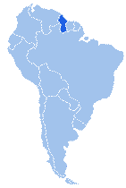
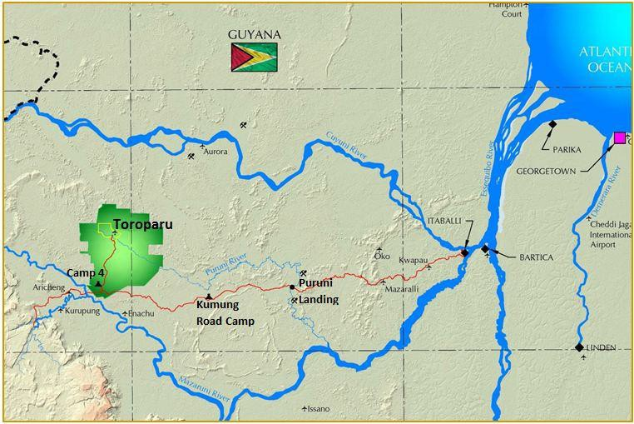

The Toroparu Gold Project
Guyana’s Largest Gold Resource
Toroparu is located in Region 7, 225 km west of Georgetown, Guyana’s capital

Slide 4

Growing WORLD-CLASS ASSET
“We measure optionality in ounces, not acres…”
- Randy Smallwood
Toroparu: Second largest gold project in South America held by a junior
Toroparu’s 7.35 Moz of in-situ gold (M&I) resources and average grade ranks it among the world’s top deposits owned by an independent junior company, and second in South America
Source: SNL
Note: Includes assets >1Moz Au M&I resource (inclusive of reserves) and in feasibility stage or earlier.

Slide 5
Development of mineral resources
Discovery to Production – Why Governmental Stability is Required for Responsible Development
The period of time between discovery of a major deposit and production has been getting longer and longer – average was 10 years in early 2000’s –now 15 years + ¹
Very Capital Intensive Industry
Toroparu:
  Multi-Million Ounce Discovery Announced 2009
  Mineral Agreement signed with Government in 2011
  Environmental Authorization issued in 2012
  Infill Drill program of 150,000 Metres completed in 2012
  Prefeasibility reported in 2013
  Gold Market retrenches 2014 - 2017
  Additional resource announced in 2017
  Project Rescoping in 2019
  Bankable Feasibility expected late 2021
Construction in 2022 and Production by the end of the 15 year average in 2024
Length of Process demands supportive Government
The Government of Guyana has always been open for Business
1. Schodde RC, "Key issues affecting the time delay between discovery and development - is it getting harder and longer?", Presentation to the PDAC, Toronto, March 2014.
5

Slide 6

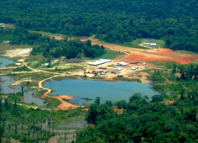
COMPANY HIGHLIGHTS
Advanced Gold Project in Guyana, South America
ETK:
  Established Presence in Guyana in 1999
  Founders have Significant History in US Mining Sector
  Private Company – Self Financed
Start Small and Learn – Small Alluvial Mining Operation
  Learn about Country and Work Force
Launch Exploration of Large Scale Property in Cooperation with Government
  ETK Constructed the main road artery in Region 7 from Itaballi to Toroparu
    Government granted temporary Royalty Reduction
    Government oversees Road Maintenance
  ETK operates Pontoon at Puruni River - Free Public Use
  ETK Developed Multiple Private Sector Joint Ventures
Major Deposit Discovery 2008 - 2009
  USD $ 25.0 Million Private Investment by 2008
Financing from Public Market - 2009
  Total Investment currently at USD $150.0 M +
  Financial Partners: Wheaton Precious Metals and Gran Colombia Gold

Slide 7
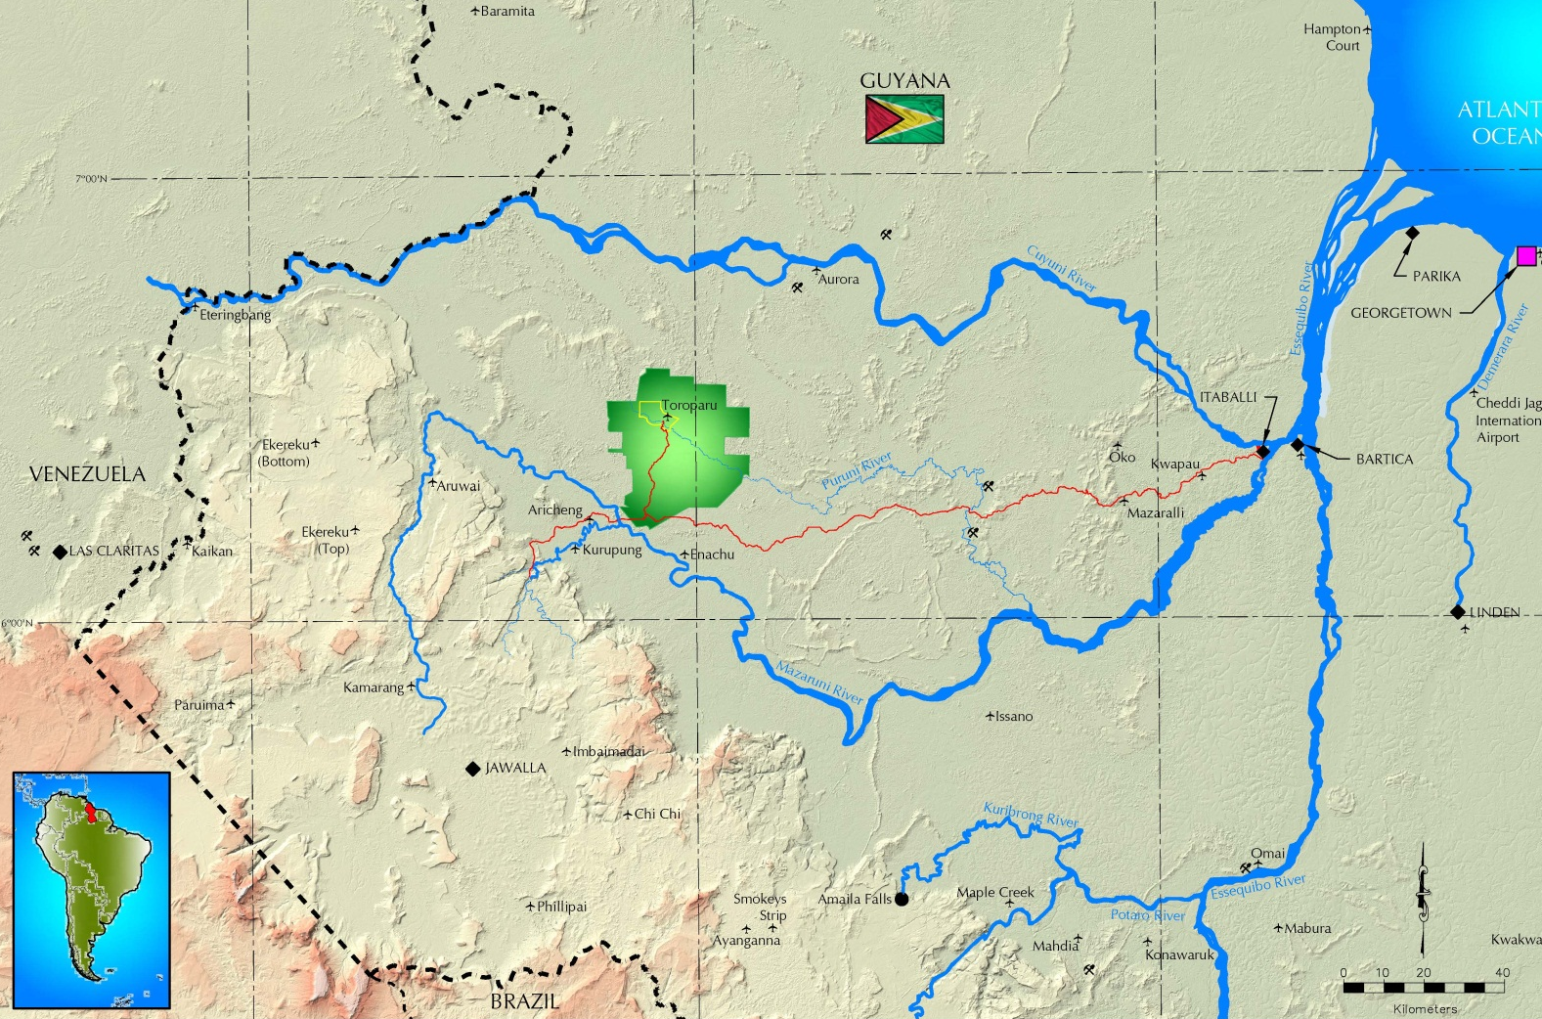
Exploration Potential
Emerging World-Class Gold District in Guiana Shield
Emerging World-Class Gold District
Cuyuni-Mazaruni Mineral Belt
18 million ounces of gold resource identified in western Guyana since 2000
Extension of 70 million ounce Bolivar Mineral District, Venezuela
(Las Cristinas, Las Brisas, Choco)
Active Exploration by Junior Explorers
High % of Guyana alluvial gold production from Cuyuni –Mazaruni District
Producing Mine at Aurora
Advanced Development at Toroparu
Major Company Interest is Growing:
Sulphur Rose
Aurora
Toroparu
Las Cristinas
Million Mountain
Peters Mine
Las Brisas
Eagle
Mountain
Omai
“The [Reunion JV] agreement expands Barrick’s exploration footprint in the Guiana Shield, a significantly underexplored region and one of the most prospective in the world for large scale gold discoveries” Mark Bristow, CEO Barrick, Feb 4, 2019
Notes:
Notes:

Slide 8
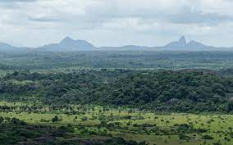
Guyana’s LOW Carbon DEVELOPMENT Strategy
Responsible Development - Length of Process demands supportive Government
“Guyana proudly accepts its share of responsibility for climate action, fighting the pandemic, and advancing along the path to sustainable development.”
  President Irfaan Ali –
“We will prepare an expanded Low Carbon Development Strategy to take into account the opportunities and challenges that have emerged since the document was first produced [in 2009], and expand it into a comprehensive development strategy.”
  Minister of Finance Ashni Singh
Toroparu needs 35 megawatts of power
  Original plan: generate power with
  Heavy Fuel Oil as does GPL
Solar can provide a small amount:
  4 to 8 megawatts seems feasible
Wind: not feasible beyond the Coast line
LNG Potential – Virtual Pipeline Concept
Hydroelelectric Alternative

Slide 9
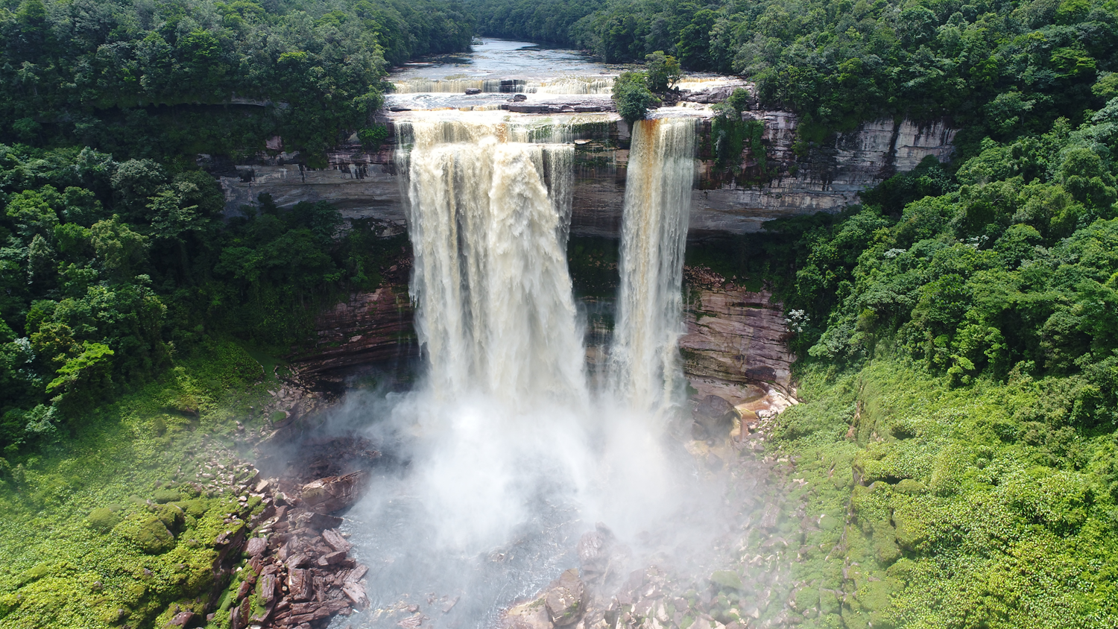
Kurupung river hydro project (”KRHP”)
^{Reduced Carbon Footprint}
Run-of-River Design – No Dam
  35 MW (241 GWh/a) hydro capacity
  for Toroparu
  Only 36% of 45.8 M³/s avg. flow capacity
  of river (MAD)
  Minimal environmental impact from
  Low Weir (6 m (26 ft.) high) & buried
  penstock Run-of-River design
  No Indigenous peoples impact
  Prefeasibility Report published in 2018
Expansion Potential to 100 MW without
  impoundment to power region and
  tie-in to national grid at Linden

Slide 10
Location – Guiana Shield
Overview of Gold Deposits
Reconstruction of the West Africa and Guiana Shields
Venezuela In-situ Gold
Choco
Las Cristinas - Las Brisas
La Camorra
Guyana
Aurora (Zijin)
Toroparu (Gold X)
Karouni (Troy)
Omai (Original Operation)
Suriname
Gros Rosebel (Iamgold)
Merian-Nassau (Newmont)
French Guiana
Yaou
Camp Caiman (Iamgold)
Choco
Christinas
Brisas
~18 Moz
~26 Moz
~1.5 Moz
Toroparu
West Omai
Aurora
Omai
Gros Rosebel
Merian-Nassau
~9 Moz
~10.5 Moz
~1.1 Moz
~4 Moz
Yaou
Caiman
~14 Moz
~4 Moz
~1 Moz
~3 Moz
TSX-V: GLDX | OTCQX: SSPXF

Slide 11
THANK YOU
ETK Inc. / Gold X
ETK Inc.
10 Atlantic Ville
Georgetown, Guyana
(509) 222-6493
www.goldxmining.com
Presenter: Rich A. Munson
CEO/Director – ETK Inc.
Email: rich@ramunson.com
US Phone: (303) 932-0384
TSX-V: GLDX OTCQX: SSPXF

