Slide 1
Exploring Trade in Aruba
Rena Rahaman - Market Development Manager
Contact: rena.rahaman@caribbrewery.com
1 868 379 6724
21st January 2021

Slide 2
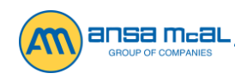
ANSA McAL - Vision and Mission Statement
Exploring Trade in Aruba
ANSA McAL shall be the leading conglomerate in the region, continuously maximising shareholder value by achieving exceptional performance, fostering long term confidence and respect while generating sustained growth for all stakeholders.
This shall be achieved by:
Always delivering superior customer service that nurtures and grows a loyal customer base
Creating an environment that encourages innovation and excellence
Attracting, developing and retaining talented people by recognising and rewarding outstanding performance
Recognising Regional and National needs and aspirations whilst protecting our environment for future generations.
https://ansamcal.com/

Slide 3
Table of Content
Exploring Trade in Aruba
Research
Define the Market
Conduct Market Analysis
Develop Market Entry Strategy
Assess Internal Capabilities
Select Distribution Partner

Slide 4
Research
Exploring Trade in Aruba
ExporTT - https://exportt.co.tt/
IWSR - https://www.theiwsr.com/
Companies already trading in Aruba
Friends & Family visiting Aruba
Market Visit

Slide 5
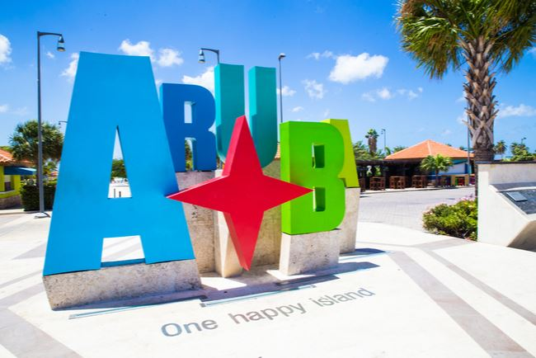
Define the Market
Exploring Trade in Aruba
Demographics:
Age
Location
Gender
Income level
Education level
Marital or family status
Occupation
Ethnic background
Consider the psychographics of your target:
Personality
Attitudes
Values
Interests/hobbies
Lifestyles
Behavior

Slide 6
Conduct Market Analysis
Exploring Trade in Aruba
Market Growth Rate
Forecasted Demand
Competitive Analysis
Barriers to Entry

Slide 7
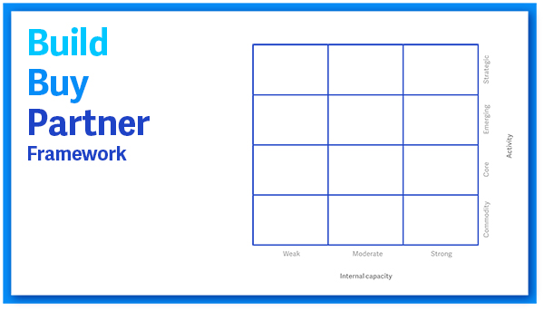
Develop Market Entry Strategy
Exploring Trade in Aruba
Decide how you enter the Market
Build
Buy
Partner

Slide 8

Assess Internal Capabilities
Exploring Trade in Aruba
Questions
How much of our core competency can we leverage?
Do we have Infrastructure in place to supply demand?

Slide 9
Select Distribution Partner
Exploring Trade in Aruba
Conduct a SWOT
Organizational Structure
Distributor’s Universe
Route to Market
Competitive landscape
Knowledgeable on the market’s culture and the everyday challenges
Network
Skilled Staff
Financial Statements

Slide 10
Exploring Trade in Aruba
Build a Strong Value Chain

Slide 11
Exploring Trade in Aruba
Challenges of doing business in Aruba
COVID Restrictions
Competitive Pricing

Slide 12
Exploring Trade in Aruba
Benefits of Doing Business in Aruba
Strategic Location
Excellent International Connection
Multilingual
Safety and Security
Educated Workforce
Infrastructure

Slide 13

Exploring Trade in Aruba
CHEERS TO ANOTHER SUCCESS STORY
THANK YOU

